Slide 1
Implement Inter-VLAN Routing
LAN Switching and Wireless – Chapter 6

Slide 2
Objectives
Explain to the satisfaction of a qualified instructor how network traffic is routed between VLANs in a converged network.
Configure inter-VLAN routing on a router to enable communications between end-user devices on separate VLANs
Troubleshoot common inter-VLAN connectivity issues.

Slide 3
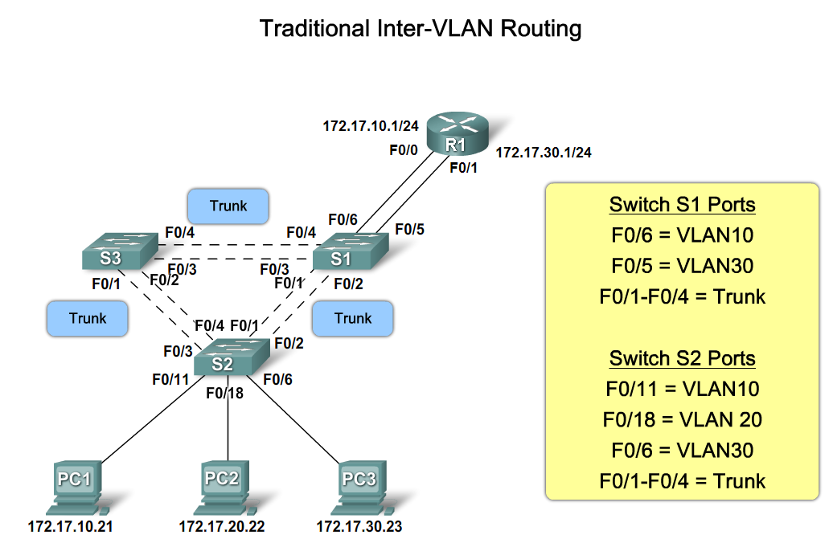
Explain How Network Traffic is Routed Between VLANs in a Converged Network
Describe the routing options between VLANs

Slide 4
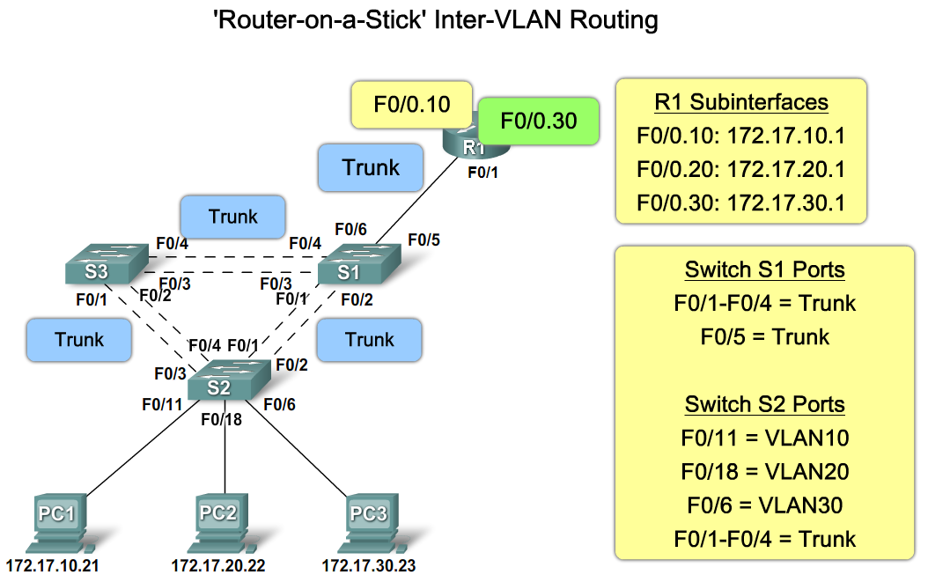
Explain How Network Traffic is Routed Between VLANs in a Converged Network
Describe the role of interfaces and subinterfaces in supporting inter-VLAN routing

Slide 5
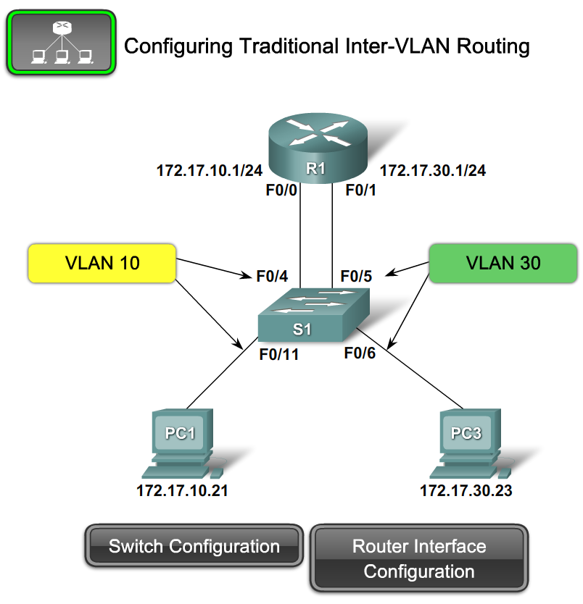
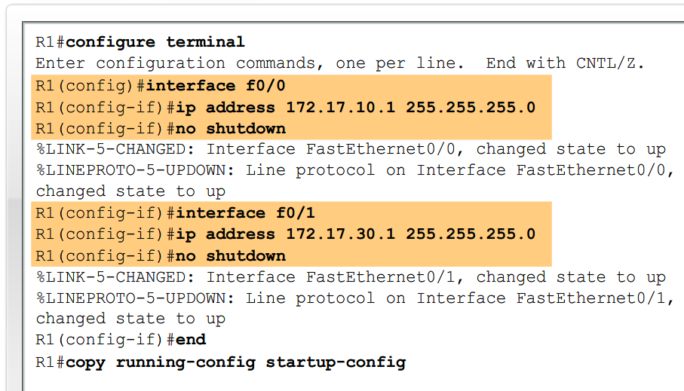
Configure Inter-VLAN Routing
Describe the steps to configure inter-VLAN routing

Slide 6
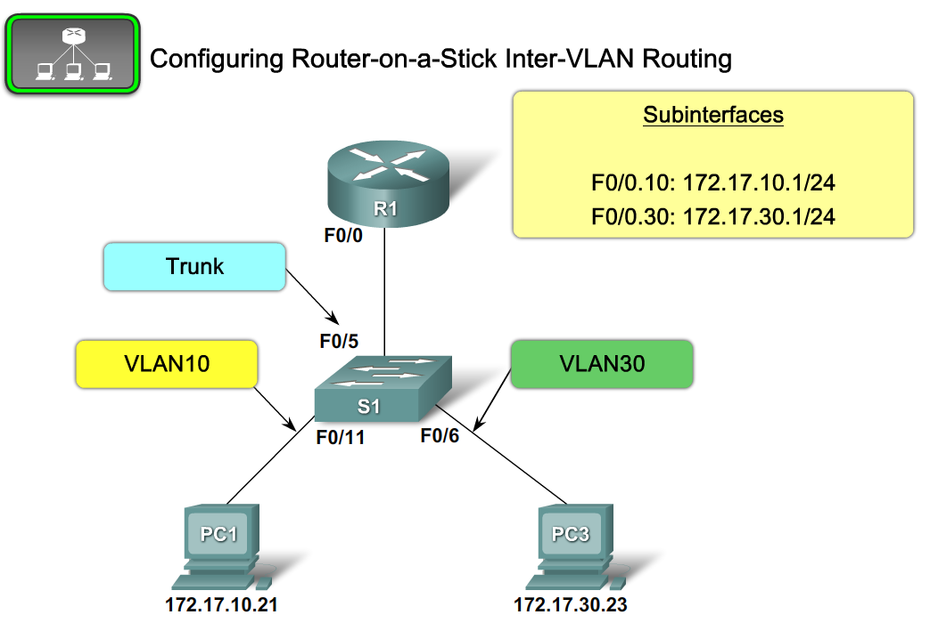
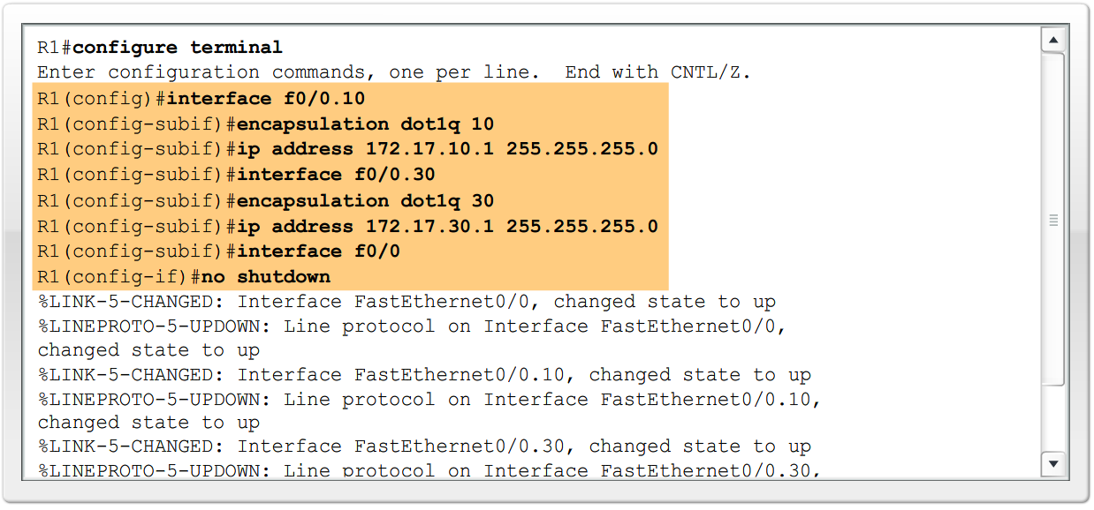
Configure Inter-VLAN Routing
Describe the steps to configure inter-VLAN routing

Slide 7
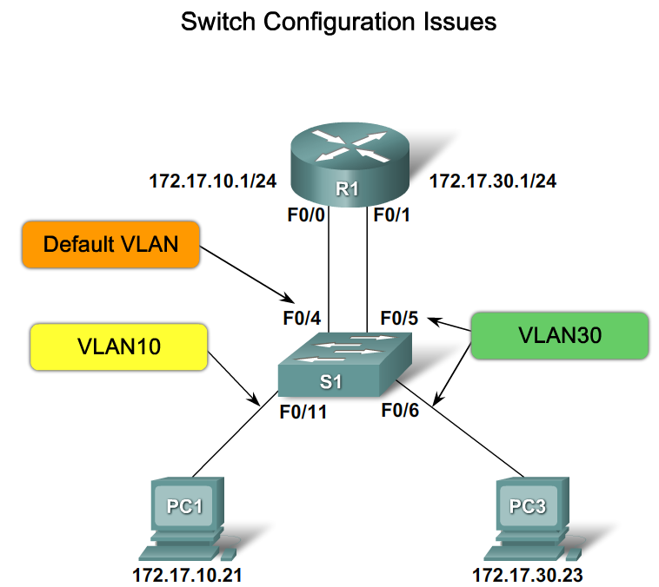
Troubleshoot Common Inter-VLAN Connectivity Issues
Describe the common switch configuration Issues

Slide 8
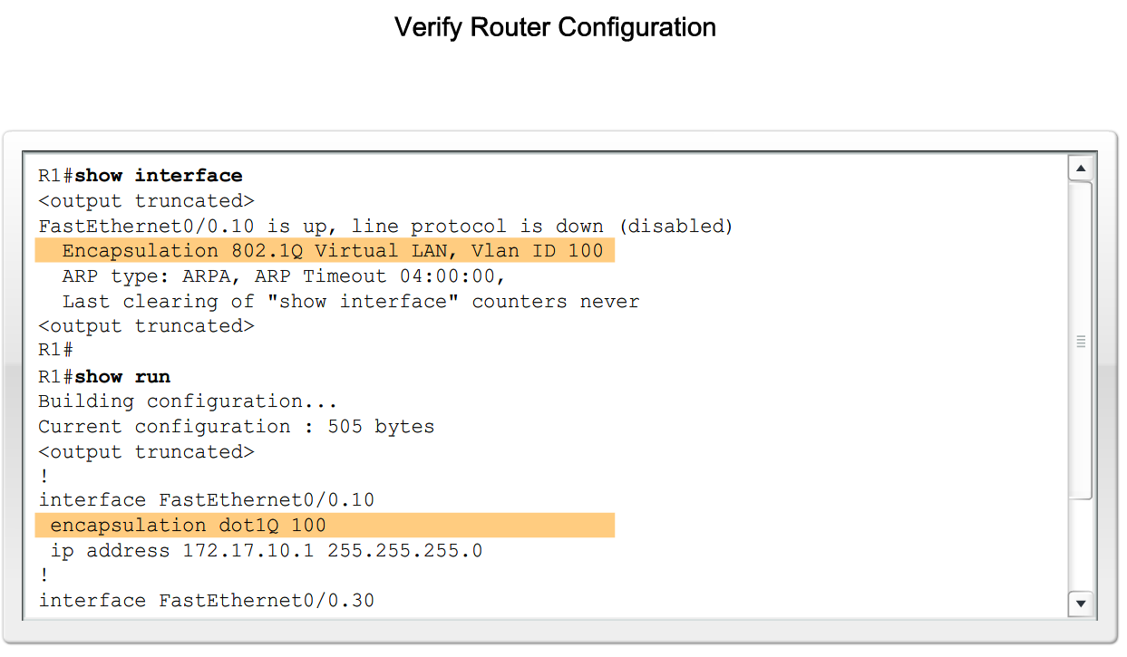
Troubleshoot Common Inter-VLAN Connectivity Issues
Describe the common router configuration issues

Slide 9
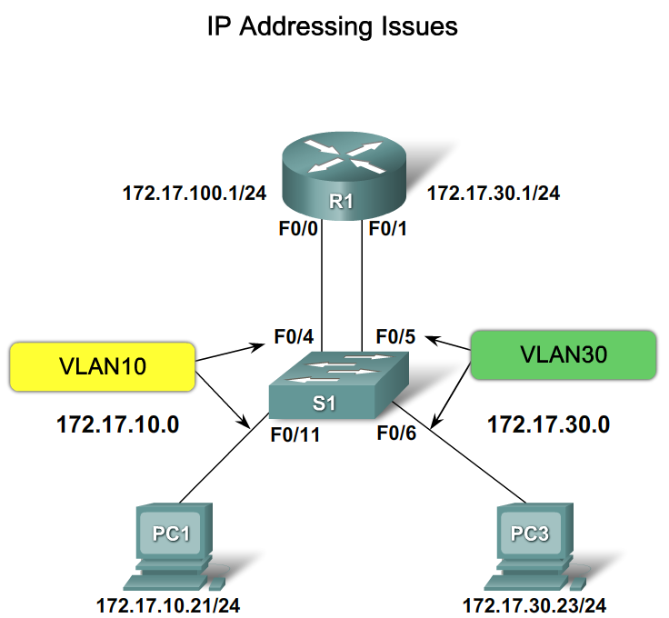
Troubleshoot Common Inter-VLAN Connectivity Issues
Describe the common IP Addressing Issues

Slide 10
Summary
Inter-VLAN routing is the process of routing information between VLANs
Inter-VLAN routing requires the use of a router or a layer 3 switch
Traditional inter-VLAN routing
  Requires multiple router interfaces that are each connected to separate VLANs

Slide 11
Summary
Router on a stick
  this is an inter-VLAN routing topology that uses router sub interfaces connected to a layer 2 switch.
  Each Subinterface must be configured with:
  An IP address
  Associated VLAN number
Configuration of inter VLAN routing
  Configure switch ports connected to router with correct VLAN
  Configure each router subinterface with the correct IP address & VLAN ID
Verify configuration on switch and router

